Slide 1

DATA VISUALIZATION
USING MATPLOTLIB

Slide 2
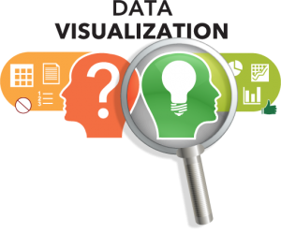
Visualization always helps in :
Better Understanding of Data
Faster Decision Making
Quick identification inaccuracies and errors in the data
Human brain can process information very easily when it is in the pictorial or graphical form.

Slide 3

What is Data Visualization ?
Data visualization is the presentation of data in a pictorial or graphical format.

Slide 4
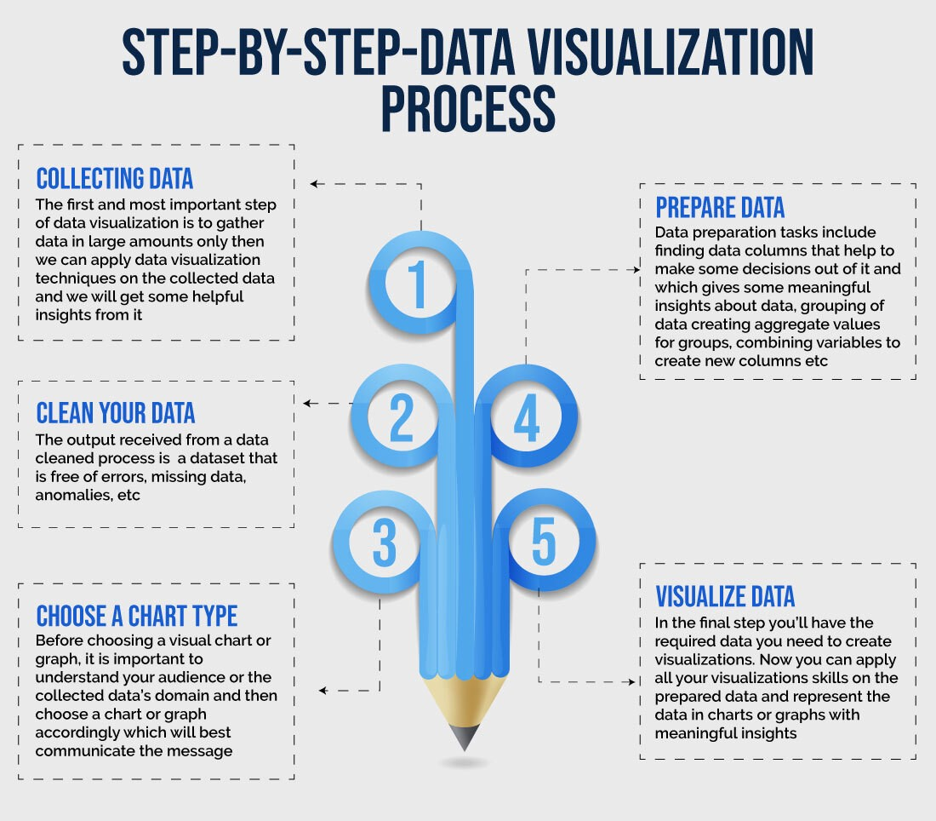

Slide 5
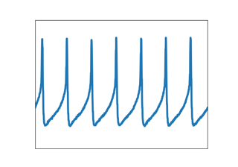
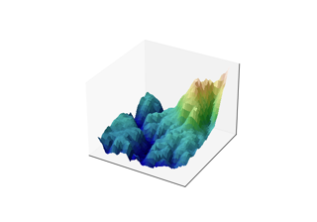
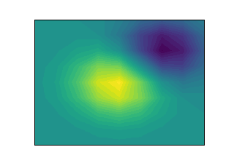
What is Matplotlib ?
Matplotlib is a comprehensive library for creating static, animated, and interactive visualizations in Python - 2D graphs.
Matplotlib makes easy things easy and hard things possible.
The pyplot, a sublibrary of matplotlib, is a collection of functions that helps in creating a variety of charts.

Slide 6
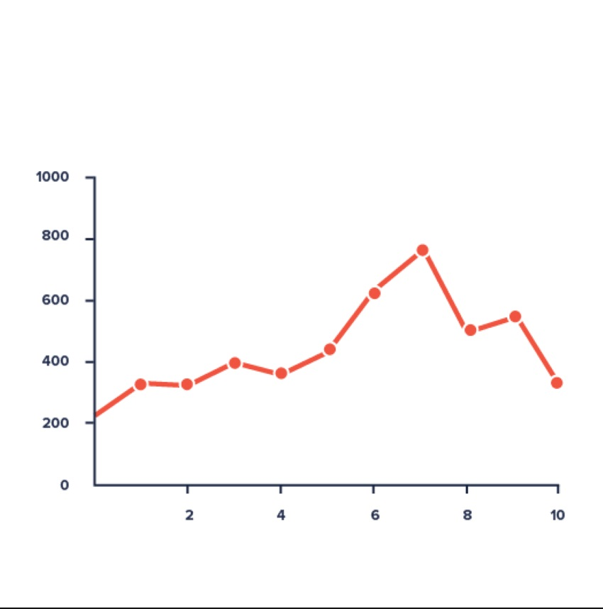
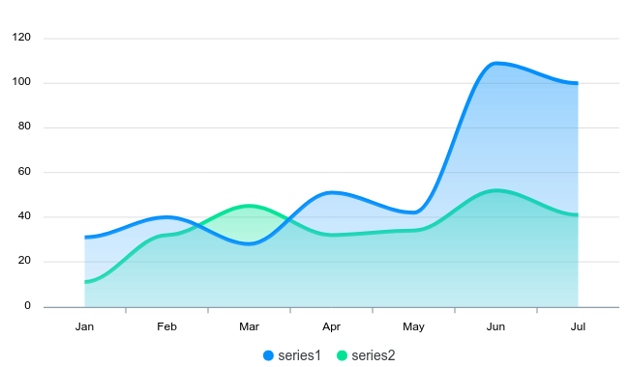
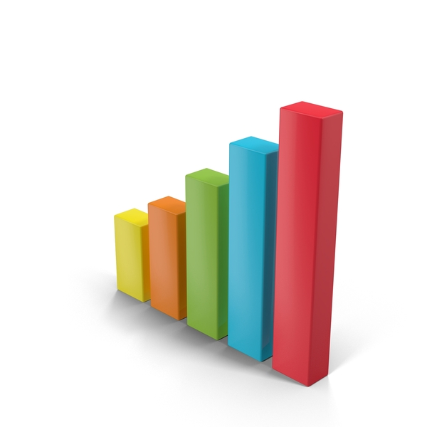
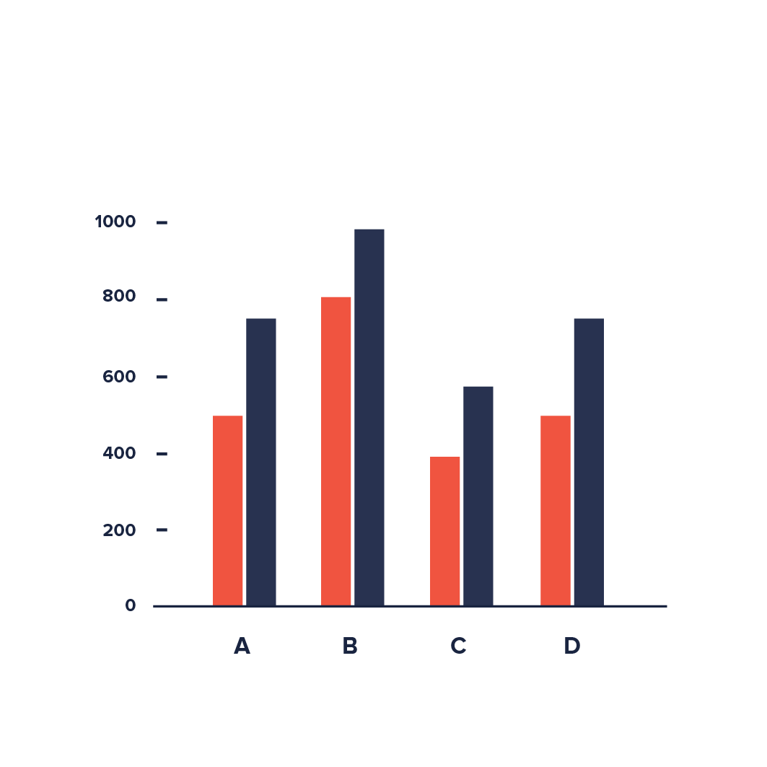
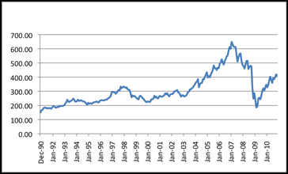
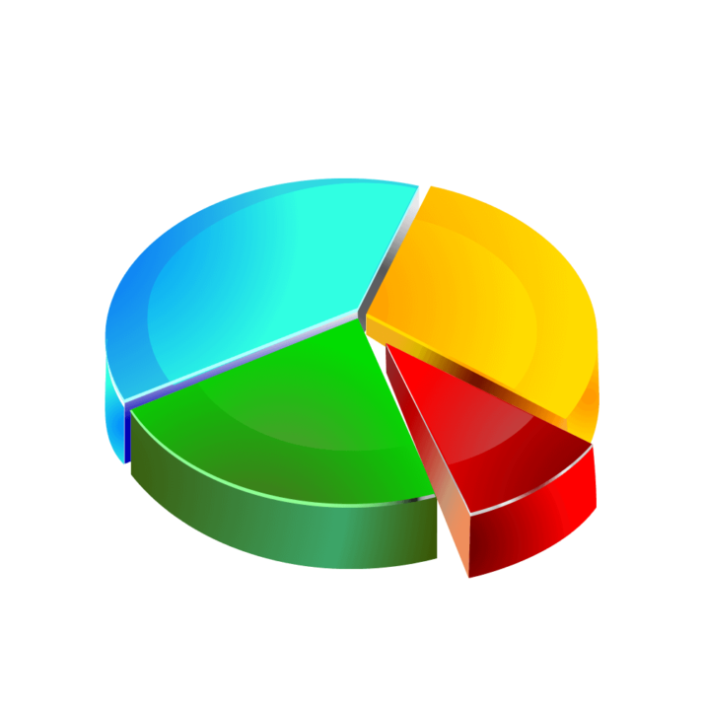
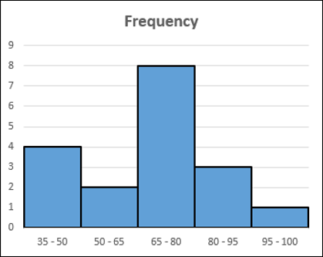
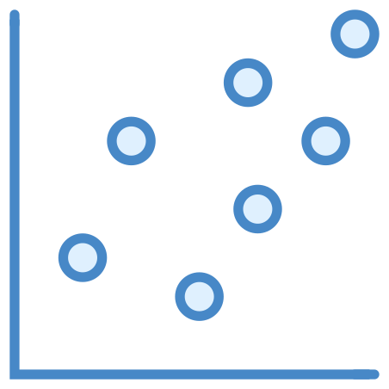
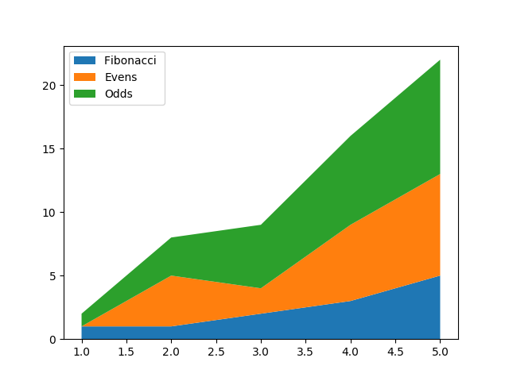
TYPES OF GRAPHS
Line plot
Area plot
Bar graph
Multiple Bar graph
Time Series Plot
Pie Chart
Stack Plot
Histogram
Scatter Plot

Slide 7

IMPORTING LIBRARIES
import matplotlib.pyplot as plt
#used for plotting
import pandas as pd
#for data manipulation and data analysis

Slide 8
LINE PLOT
Line charts are used to represent the relation between two data X and Y on a different axis.

Slide 9
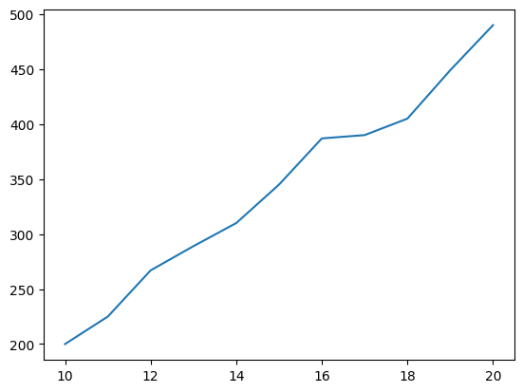
OUTPUT :
CODE :
Let us generate a simple line plot.
x = [10,11,12,13,14,15,16,17,18,19,20]
y = [200,225,267,289,310,345,387,
390,405,449,490]
plt.plot(x,y) #giving input for x and y axis
plt.show() #to show the plot

Slide 10
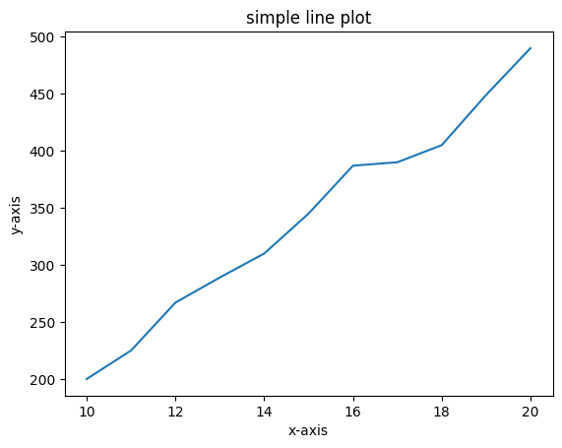
OUTPUT :
CODE :
Adding more information to the plot.
x = [10,11,12,13,14,15,16,17,18,19,20]
y = [200,225,267,289,310,345,387,390,405,
449,490]
plt.plot(x,y)
plt.title('simple line plot') #giving title for the plot
plt.xlabel('x-axis') #labelling x-axis
plt.ylabel('y-axis') #labelling y-axis
plt.show()

Slide 11
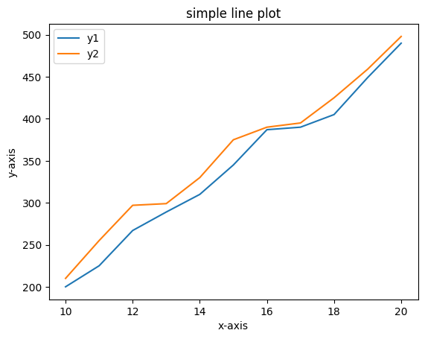
OUTPUT :
CODE :
Compare two plots
x = [10,11,12,13,14,15,16,17,18,19,20]
y1 = [200,225,267,289,310,345,387,390,405,449,490] #first variable for y-axis
y2 = [210,255,297,299,330,375,390,395,425,459,498] #second variable for y-axis
plt.plot(x,y1 , label = 'y1') #plotting first graph with label
plt.plot(x,y2 , label = 'y2') #plotting second graph with label
plt.title('simple line plot')
plt.xlabel('x-axis')
plt.ylabel('y-axis')
plt.legend() #to show labels
plt.show() #to show the plot

Slide 12
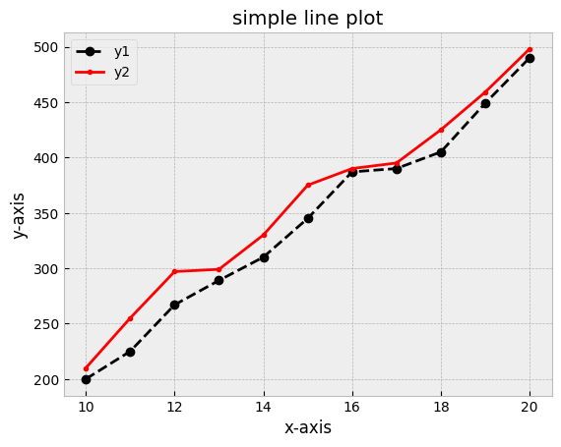
OUTPUT :
CODE :
Add colours and linestyle to the plot
X = [10,11,12,13,14,15,16,17,18,19,20]
y1 = [200,225,267,289,310,345,387,390,405,449,490]
y2 = [210,255,297,299,330,375,390,395,425,459,498]
plt.plot( X,y1 ,color = 'k' , linestyle = '--' , label = 'y1' , marker = 'o') #k= black colour & -- = dotted line with markers
plt.plot(X,y2 , color = 'r' , label = 'y2' , marker = '.')
#r = red line with markers “ . ”
plt.title('simple line plot')
plt.xlabel('x-axis')
plt.ylabel('y-axis')
plt.legend()
plt.grid(True) #shows grid in the background
plt.show()

Slide 13
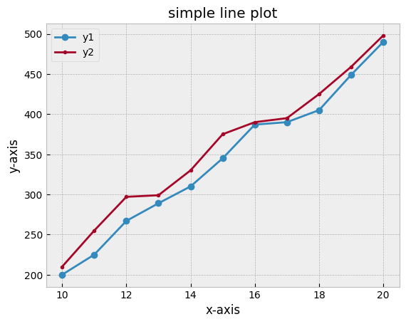
OUTPUT :
CODE :
Add style to the plot
print(plt.style.available) #to know the available styles
plt.style.use('bmh') #selecting bmh style
#plt.style.use(‘default’) → to get back default style
X = [10,11,12,13,14,15,16,17,18,19,20]
y1 = [200,225,267,289,310,345,387,390,405,449,490]
y2 = [210,255,297,299,330,375,390,395,425,459,498]
plt.plot(X, y1 , label = 'y1' , marker = 'o')
plt.plot(X, y2 , label = 'y2' , marker = '.')
plt.title('simple line plot')
plt.xlabel('x-axis')
plt.ylabel('y-axis')
plt.legend()
plt.show()
This is the same line plot as seen before with the modified style .

Slide 14
AREA PLOT
An area chart is really similar to a line chart, except that the area between the x axis and the line is filled in with color or shading.

Slide 15
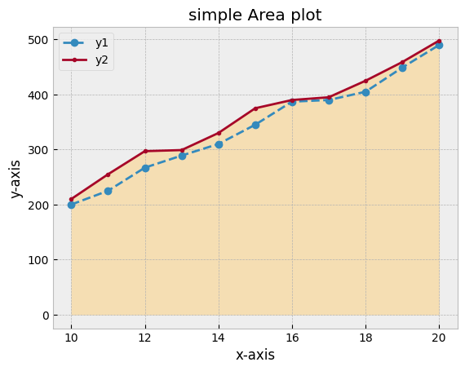
OUTPUT :
CODE :
Let us build a simple area plot :
X = [10,11,12,13,14,15,16,17,18,19,20]
y1 = [200,225,267,289,310,345,387,390,405,449,490]
y2 = [210,255,297,299,330,375,390,395,425,459,498]
plt.plot(X ,y1 , label = 'y1' , marker = 'o' , linestyle = '--')
plt.plot(X ,y2 , label = 'y2' , marker = '.')
plt.title('simple Area plot')
plt.xlabel('x-axis')
plt.ylabel('y-axis')
plt.fill_between(x,y2 , color = 'wheat') #to fill the area
plt.legend()
plt.show()
This is the same line plot as seen before with the area filled between X and y2 .

Slide 16
BAR PLOT
A bar plot or bar chart is a graph that represents the category of data with rectangular bars with lengths and heights that is proportional to the values which they represent. The bar plots can be plotted horizontally or vertically.

Slide 17
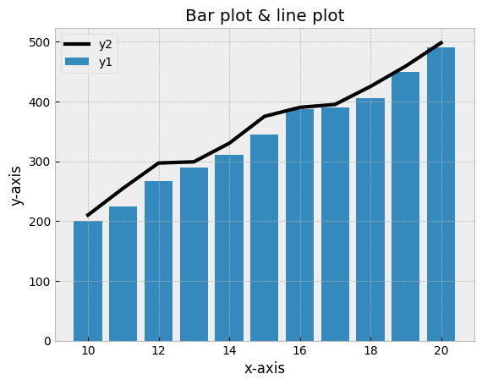
OUTPUT :
CODE :
Let us build a simple Bar plot with Line :
X = [10,11,12,13,14,15,16,17,18,19,20]
y1 = [200,225,267,289,310,345,387,390,405,449,490]
y2 = [210,255,297,299,330,375,390,395,425,459,498]
plt.bar(X ,y1 , label = 'y1') #bar plot
plt.plot(X ,y2 , label = 'y2' , color = 'k' , linewidth = 3) #line plot
#If the line is not needed the above code line can be skipped
plt.title('Bar plot & line plot')
plt.xlabel('x-axis')
plt.ylabel('y-axis')
plt.legend()
plt.show()

Slide 18
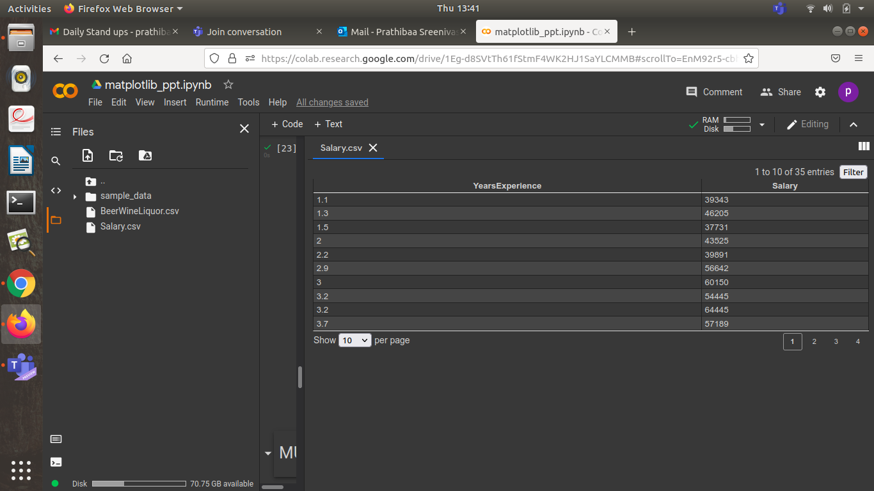
WORKING WITH A DATASET
Consider the following data , where the experience and salary of the employees are listed.

Slide 19
WORKING WITH A DATASET
Preparing Data for visualization :
import pandas as pd #pandas
df = pd.read_csv('Salary.csv') #Loading a csv file
df.head(10) #Printing first 10 values
top_10 = df['Salary'].sort_values(ascending = False).head(10)
#after sorting we will get top 10 employees with highest salary
top_10 = top_10.sort_index()
#sorting experience in ascending order
top_10 = top_10.to_frame()
#converting series into dataframe

Slide 20
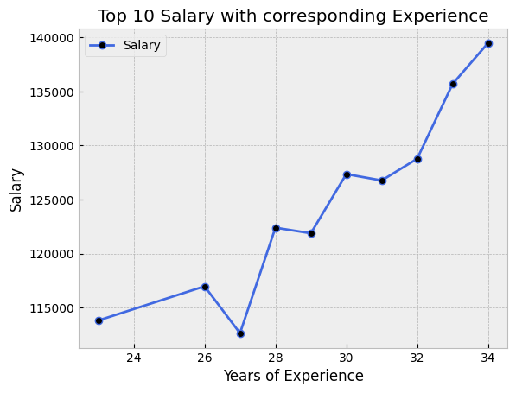
OUTPUT :
CODE :
Line Plot :
plt.plot ( top_10 , label = 'Salary' , marker = 'o' , color = 'royalblue' , MarkerFaceColor = 'k' )
#specifying marker color
plt.title('Top 10 Salary with corresponding Experience')
plt.xlabel('Years of Experience')
plt.ylabel('Salary')
plt.legend()
plt.grid(True)
plt.show()

Slide 21
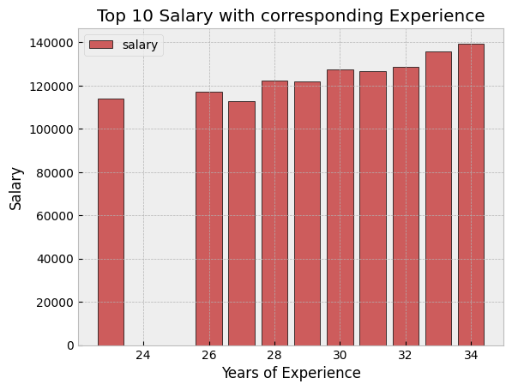
OUTPUT :
CODE :
Vertical Bar Plot :
experience = top_10.index
#creating variable from dataframe
salaries = top_10['Salary']
#creating variable from dataframe
plt.bar(experience , salaries , label = 'salary' ,
color = 'indianred' , edgecolor = 'k')
plt.title('Top 10 Salary with corresponding Experience')
plt.xlabel('Years of Experience')
plt.ylabel('Salary')
plt.legend()
plt.show()

Slide 22
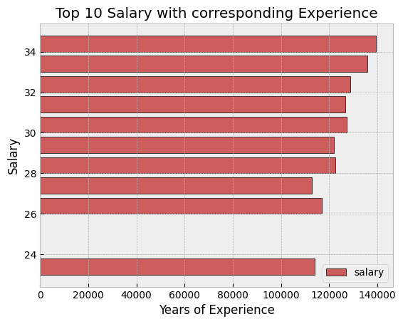
OUTPUT :
CODE :
Horizontal Bar Plot :
experience = top_10.index
salaries = top_10['Salary']
plt.barh(experience , salaries , label = 'salary' ,
color = 'indianred' , edgecolor = 'k')
#barh instead of bar
plt.title('Top 10 Salary with corresponding Experience')
plt.xlabel('Years of Experience')
plt.ylabel('Salary')
plt.legend()
plt.show()

Slide 23
MULTIPLE BAR CHART
A multiple bar chart is also called a Grouped Bar chart.Multiple bar charts are generally used for comparing different entities.

Slide 24
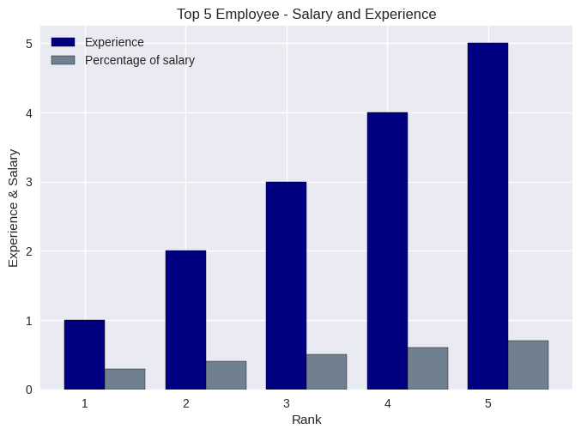
CODE :
OUTPUT :
Multiple Bar Plot :
X = [1,2,3,4,5] #used as x-axis values
experience = [1,2,3,4,5]
salary_Percentage = [0.3 , 0.4 , 0.5 , 0.6 , 0.7]
width = 0.4 #width of the bar
bar1 = np.arange(len(x))
bar2 = [i+width for i in bar1]
plt.bar(bar1 , experience , width , label = 'Experience' , edgecolor = 'k' ,
color = 'navy')
plt.bar(bar2 , salary_Percentage , width , label = 'Percentage of salary' , edgecolor = 'k' , color = 'slategrey')
plt.xlabel('Rank')
plt.ylabel('Experience & Salary')
plt.title('Top 5 Employee - Salary and Experience')
plt.legend(edgecolor = 'k')
plt.xticks(bar1 , x) #to get original X-value

Slide 25
PIE CHART
A Pie Chart is a circular statistical plot that can display only one series of data. The area of the chart is the total percentage of the given data. The area of slices of the pie represents the percentage of the parts of the data. The slices of pie are called wedges.

Slide 26
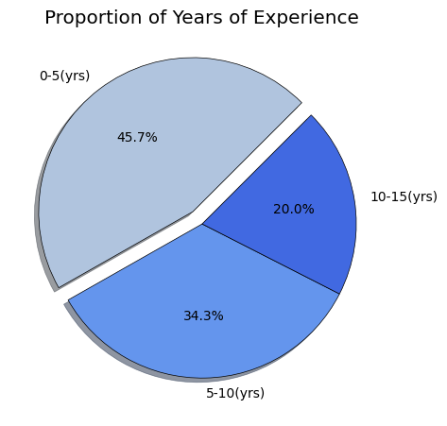
CODE :
OUTPUT :
Pie chart :
exp_yrs = df['YearsExperience']
x1 = [i for i in exp_yrs if 0<i<5] #less than 5 yrs of experience
x1 = len(x1) #to get the count
x2 = [i for i in exp_yrs if 5<i<10]
x2 = len(x2)
x3 = [i for i in exp_yrs if 10<i<15]
x3 = len(x3)
my_pie = [x1,x2,x3]
labels = ['0-5(yrs)' , '5-10(yrs)' , '10-15(yrs)']
colors = ['lightsteelblue' , 'cornflowerblue' , 'royalblue']
explode = [0.1 , 0 , 0]
plt.title('Proportion of Years of Experience')
plt.tight_layout()
plt.pie(my_pie , labels = labels , colors = colors , wedgeprops = {'edgecolor' : 'black'} , explode = explode , shadow = True , startangle= 45 , autopct = '%1.1f%%')
plt.show()
0-5 years experience wedge is shown exploded .
( with maximum percentage)

Slide 27
HISTOGRAM
A histogram shows the frequency on the vertical axis and the horizontal axis is another dimension. Usually it has bins, where every bin has a minimum and maximum value. Each bin also has a frequency between x and infinite.

Slide 28
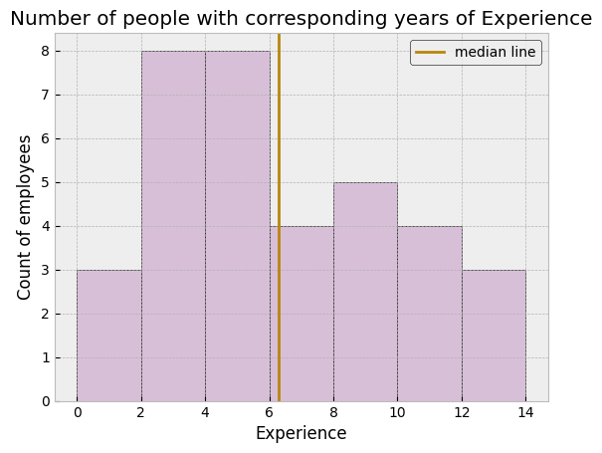
OUTPUT :
CODE :
Histogram :
exp = df['YearsExperience']
mean = exp.mean() #finding average
bins = [0,2,4,6,8,10,12,14] #interval of x-axis
plt.hist( exp , bins = bins , edgecolor = 'black' , color = 'thistle')
plt.axvline( mean , color = 'darkgoldenrod' , label = 'median line')
plt.title('Number of people with corresponding years of Experience')
plt.xlabel('Experience')
plt.ylabel('Count of employees')
plt.legend(edgecolor = 'k')
plt.show()
“6”(approx.) is the average experience of the employees in the company.

Slide 29
SCATTER PLOT
A scatter plot is a diagram where each value in the data set is represented by a dot.Scatter plots are used to plot data points on a horizontal and a vertical axis in the attempt to show how much one variable is affected by another.

Slide 30
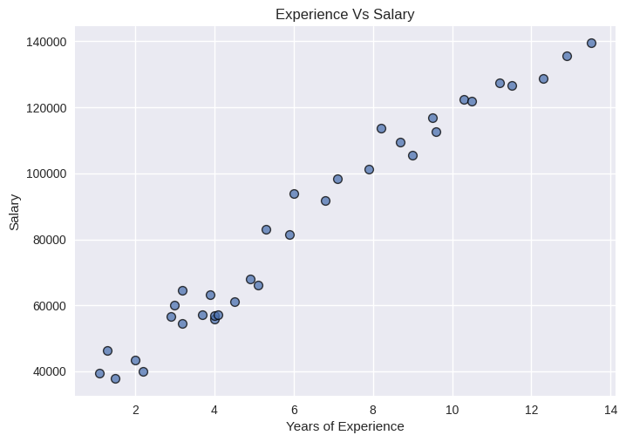
OUTPUT :
CODE :
Scatter Plot :
plt.style.use('seaborn')
#create variables
x = df['YearsExperience']
y = df['Salary']
plt.scatter(x,y , s = 50 , edgecolor = 'k' , linewidth = 1 , alpha = 0.75)
plt.title('Experience Vs Salary')
plt.xlabel('Years of Experience')
plt.ylabel('Salary')
plt.show()
This shows a clear linear relationship .That is , As the value of x-axis increase the value of y-axis also increases.

Slide 31
STACK PLOT
Stack plots show each part stacked onto one another and how each part makes the complete figure.The idea of stack plots is to show “parts to the whole” over time. It is used to represent various datasets without overlapping over each other.

Slide 32
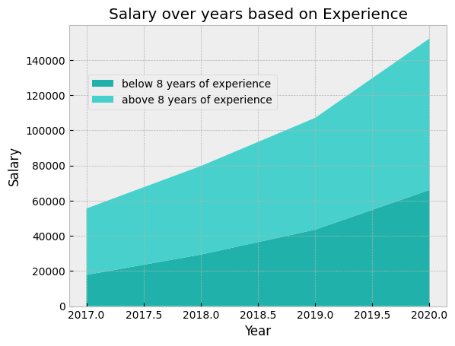
OUTPUT :
CODE :
Stack Plot :
#consider the following data
year = [2017 , 2018 , 2019 , 2020]
salary_below_8_yrs = [17761 , 29343 , 43515 , 66105]
Salary_above_8_yrs = [37791 , 50344 , 63575, 86140 ]
labels = ['below 8 years of experience' , 'above 8 years of experience']
colors = ['lightseagreen', 'mediumturquoise']
plt.stackplot( year , salary_below_8_yrs , salary_above_8_yrs , labels = labels , colors = colors )
plt.title('Salary over years based on Experience')
plt.xlabel('Year')
plt.ylabel('Salary')
plt.legend(loc = (0.05 , 0.7))
plt.show()

Slide 33
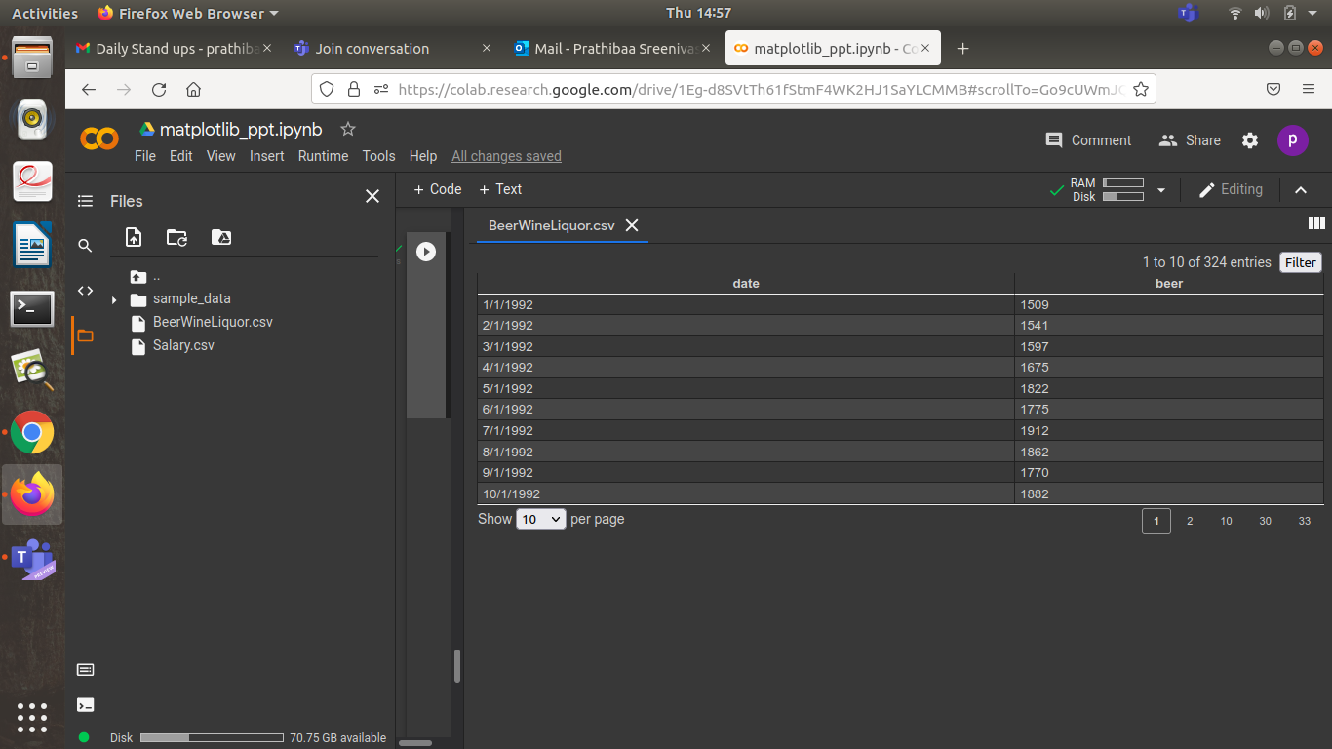
WORKING WITH A DATASET
The following is a time series data from a beer company , where the date sold and price for which it is sold are given.

Slide 34
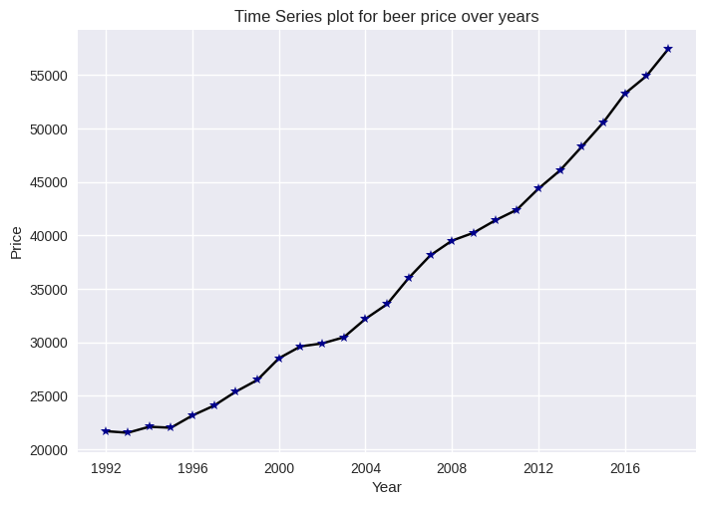
OUTPUT :
CODE :
Time Series Plot :
#loading a csv file
data = pd.read_csv('BeerWineLiquor.csv')
data['date'] = pd.to_datetime(data['date'])
data = data.resample('YS' , on = "date").sum()
#converting daily data to annual data
data.info()
#gives variables present in the data frame along with its type
dates = data.index
beer_price = data['beer']
plt.plot_date(dates , beer_price , linestyle = 'solid' , MarkerFacecolor = 'darkblue' , color = 'k' , marker = '*' )
plt.title('Time Series plot for beer price over years')
plt.xlabel('Year')
plt.ylabel('Price')
plt.show()
This shows a clear linear relationship.That is , As the year increases the price also increases.

Slide 35
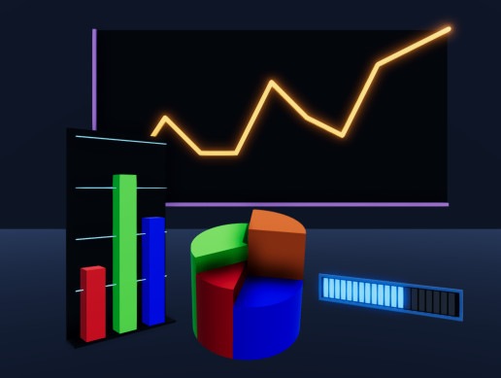
THANKS!

